Slide 1
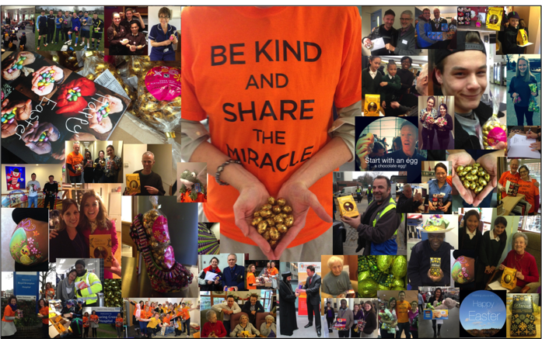
Easter 2017 – Your Top Tips guide to create your own event and share your good news!

Slide 2
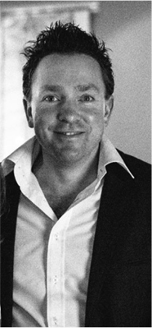
Thank you for sharing the miracle!
Easter is approaching and it’s almost time to ShareTheMiracle in your community.
With your help, we are looking forward to this being the best year yet!
We believe that we are all designed for kindness and that kindness can help to transform YOUR communities this Easter.
Wishing you a very Happy Easter.
Dan
Daniel Usher, Founder, ShareTheMiracle

Slide 3
What are the key steps I need to take to ShareTheMiracle?
1) GIVE
Identify a person, or group of people and present them with the gift of an Easter Egg, or a gift of your choosing. Discounted eggs are available at ShareTheMiracle.org
2) INVITE
Plan an event, big or small, and invite recipients via the ShareTheMiracle Easter card invitations
3) SHARE
Don’t keep it to yourself! Record the experience, from the giving of the gift to the event itself

Slide 4
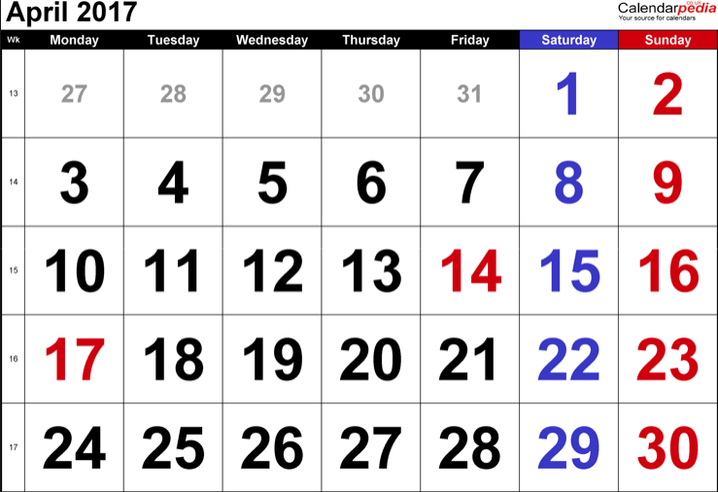
When should I hold my ShareTheMiracle event?
ShareTheMiracle is an Easter initiative. So, this year teams will tend to engage from mid March through to the Easter weekend (14th to 16th April, 2017)

Slide 5
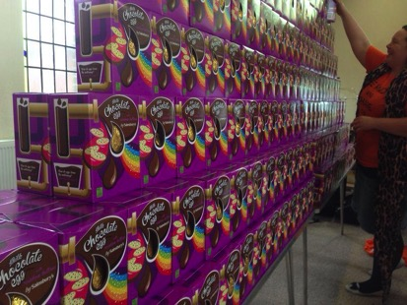
How can I get started – How do I get the Easter eggs?
1. Buy your chocolate eggs
Discounts available at ShareTheMiracle.org
2. Ask your community to donate eggs
3. Ask an individual or company to sponsor eggs (e.g. a local supermarket, business proprietor)
4. Welcome donations from which to buy eggs – don’t forget to negotiate with the supplier!
5. ShareTheMiracle may be able to offer groups chocolate eggs/donations as resources permit

Slide 6
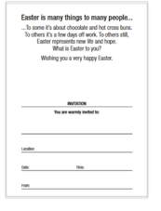
Use your ShareTheMiracle Easter card Invitations to:
1) Invite people to an event or occasion that you are planning on holding – it doesn’t need to be anything big
2) As a tool for social action. e.g. you recognise a challenge with loneliness amongst the elderly in your community so you decide to gather your team and visit an elderly home, giving out Easter eggs. To make it fun and memorable you could invite those present to sing with you, you could read to them, play a board game, share a slice of cake, or simply just listen... get your team together and plan a fun event.
3) As a simple way just to start a conversation and build a relationship. E.g. Why not pop an invitation through a letter box and invite a neighbour for a coffee?
We’ve done all the hard work so all you have to do is fill in the details of your event on the inside of the card:

Slide 7
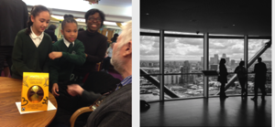
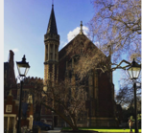
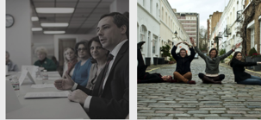
Here are some ideas of events that you could invite people to:
Schools: Open day, concert, quiz, exhibition
Businesses: Product launch, Egg collection station, Family fun day, CSR initiative
Churches: Easter service, youth groups, mums & toddlers group, Luncheon club
Voluntary Groups: Fundraiser, coffee morning, to try volunteering
Local Councils: Intergenerational project, Community event, family fun day
Neighbours: Street party, dinner, a coffee

Slide 8
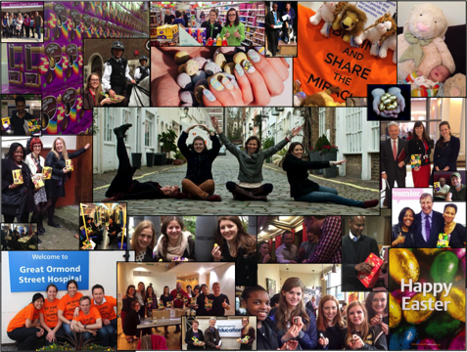
Why is it important to share my ShareTheMiracle story?
Don’t keep it to yourself! Record the experience, from the giving of the gift to the event itself, and share through ShareTheMiracle. Whether you want to write it in words or capture it in photos or videos, you can do so HERE
Sharing your event on social media helps to inspire and encourage others to get involved too. Tag your pictures with #DesignedForKindness and #ComeAlive and we’ll find them and amplify your message!
Email: Info@ShareTheMiracle.org
Instagram: @ShareTheMiracle
Facebook: ShareMiracleUK
Twitter: @ShareMiracleUK

Slide 9
How can I best share our event with our local media so that other people know what is happening?
It doesn’t need to be a big event to share with your local media – they are often just looking for stories to brighten their readers’ pages. Download ‘Your Press Release’ from the ShareTheMiracle website which is a simple template for a press release that you can adapt and then email to your local paper
Simply complete the sections in yellow with your tailored information and delete any copy you don’t want and then send to your local newspaper – you will be able to find their contacts on Google. If you don’t feel like sending a press release you can just ring up and tell them your story and invite them to come along and take some photos
It would be awesome if you could copy info@sharethemiracle.org into the press release you send out. It allows us to centrally keep track of all the great local projects, and be prepared to answer any telephone calls for more information
You may want to invite your local newspaper to come to your event and take a photograph too

Slide 10
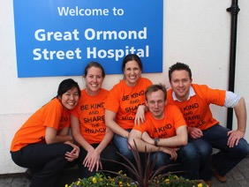
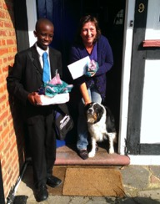
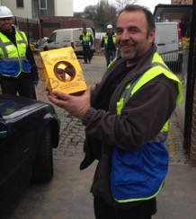
You are wonderful part of something much larger...
In 2015, groups ran ShareTheMiracle up and down the country in Great Ormond Street Hospital, through Westminster council, schools, churches, to the homeless, elderly, victims of human trafficking and more. Its been so exciting to see it grow from engaging 100 people during Easter 2013 to engaging over 23,000 people across the UK last Easter
By engaging in ShareTheMiracle this Easter you join with groups far and wide in helping transform your communities through acts of kindness.

